Slide 1
Practical Nursing Program
Application Process and Info

Slide 2
So you wish to attend the NTCC Practical Nursing Program?
This is the right place!!!
We will cover when and where we offer this program
Admission Requirements
At the end you will find out how to study for the tests required!

Slide 3
Practical Nursing Program
When and Where are we accepting our next cohorts?

Slide 4
When Are These Offered?
Offered at the following campuses:
Hammond
Takes in a new Traditional Freshmen class (day program) each Fall and Spring
Accelerated MA to PN cohort as needed (next one will be TBD)
Hammond is the only campus with an evening program – next evening class slated to begin Fall 2024
Lacombe
Next class offered will tentatively start Spring of 2025
Accelerated MA to PN cohort taking in a class Spring 2024 and Spring 2025
Sullivan (Bogalusa)
Usually takes in new Freshmen class each Fall and Spring
Livingston (Walker)
Next class offered Fall 2024
Florida Parishes (Greensburg)
Next Freshmen Cohort to start Spring 2024

Slide 5
Duration of the Traditional Practical Nursing Program
18 months in duration/4 semesters
Spring Start = Spring, Summer, Fall, & Spring
Fall Start = Fall, Spring, Summer, & Fall
Traditional Daytime cohorts meet as follows:
Spring and Fall semesters Mon-Thur (classes are between 7am or 8am to 3:30pm or 4:30pm) and Fri 8am-12pm
Monday-Thursday in Summer (classes are usually 9hrs at 7am-4pm)
Clinical Days: require start time as early as 5:30am, depending on the shift times of the facility in which you are assigned clinical experience

Slide 6
Duration of the Traditional Practical Nursing Program
Traditional Evening cohort (Hammond Campus Only) meet as follows:
Spring and Fall semesters
Mon 5pm-9pm
Tues-Wed 1p-9p
Thurs-Fri 2p-10p
Summer semester
Mon-Thurs 1p-11pm
Clinical Days: subject to be earlier than class times based on shift changes and clinical availability

Slide 7
Duration of the Accelerated Certified Medical Assistant to Practical Nursing Program
12 months in duration/3 semesters
Spring Start = Spring, Summer & Fall
Summer Start Summer, Fall, & Spring
Accelerated Daytime cohorts meet as follows:
Expect to be in class around 40 hours a week Monday-Friday
Hours will change depending on clinical classes

Slide 8
Duration Practical Nursing Programs
For all our Practical Nursing programs, classes do not follow the college Academic calendars exactly as posted. Meaning, they may meet prior to the semester start or stay later than is posted in order to reach the clock hour requirements mandated by the LSBPNE
Schedules posted are subject to change

Slide 9
Additional Basic Information for you about the Certified Medical Assistant to Practical Nurse Cohorts
Lacombe Campus
Spring 2024 and Spring 2025
Hammond Campus
TBD
If you are applying to the CCMA to PN program, please fill out the appropriate application-do not complete the PN application we are discussing here. All pertinent information is found at the bottom of our Practical Nursing website.

Slide 10
Additional Basic Information for you about the Certified Medical Assistant to Practical Nurse Cohorts
Some of our Industry partners have designated sponsored seats that they have an internal interview process for.
North Oaks sponsorship: please contact Erika Williams at Hammond campus for more information 985-545-1522
Ochsner sponsorship: please contact Courtney Jones for more information 985-545-1259

Slide 11
Practical Nursing Program
Governing Bodies

Slide 12
Important to Note:
All Practical Nursing Programs are regulated and governed by the Louisiana State Board of Practical Nurse Examiners (LSBPNE) and NTCC is accredited by LSBPNE to offer PN Programs at all 5 campuses at this time. NTCC is also SACSCOC accredited.
The program is highly regulated and has many requirements that must be met prior to admission, during the program, and at completion and/or graduation.
The PN Program is fast-paced and rigorous and requires your full attention to succeed. Due to this, LSBPNE and NTCC strongly discourage working while in school and PN students should never attempt to work full time at any point in the program.

Slide 13
Practical Nursing Program
Admission Criteria

Slide 14
Practical Nursing Admission Requirements
There are certain Criteria and Standards that must be met to be eligible to apply to the Practical Nursing Program at NTCC.
These criteria must be met prior to a student applying to program.
Please note: Applications that are missing minimum eligibility criteria / standards will not be processed.

Slide 15
Practical Nursing Admission Requirements
This is a limited/select enrollment program.
Students must complete requirements, be selected, and admitted to the PN program to enroll in any of the PN courses.
2.0 GPA
Appropriate Accuplacer, ACT, or TEAS scores
As of Spring 2023, there are 3 paths to admittance into the Practical Nursing Program
Meeting with Financial Aid –form required

Slide 16
PN Program Admission Requirements
1. Students must have a prior minimum grade point average (GPA) of 2.0.
This GPA will be cumulative of all college level courses taken by the student.
If the student has not taken any college courses at the time of application, the High School GPA will be utilized.
If the student has not taken any college courses at the time of application and completed High School through GED or HiSET, the GED or HiSET raw scores will be converted to a GPA.
Please NOTE: We must have all raw scores on a GED or HiSET raw scores to consider any applicant for admission.

Slide 17
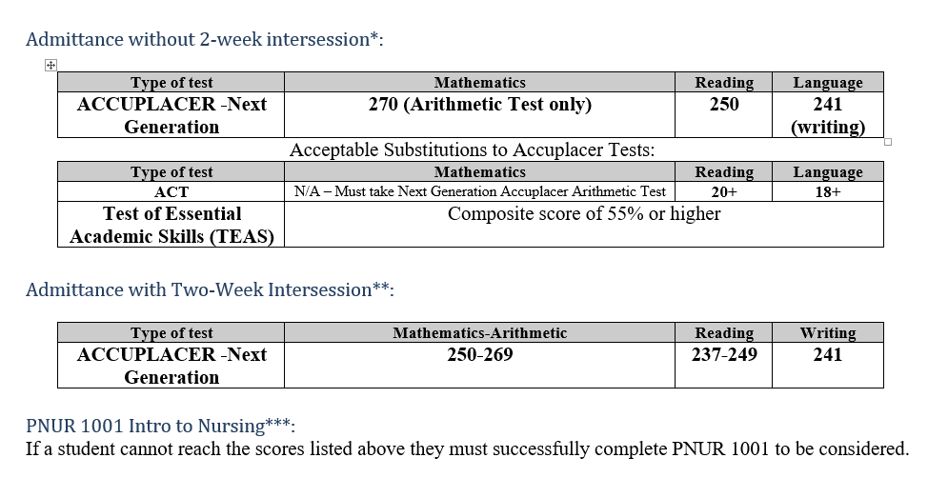
PN Program Admission Requirements
2. students must meet or exceed entrance tests
As of Spring 2023, there are 3 paths to entry into the Practical Nursing Program, below are listed the three ways:

Slide 18
PN Program Admission Requirements
Admittance without Intersession
ACCUPLACER, ACT, and TEAS test scores are valid for (3) three years.
Candidates whose scores meet or exceed the ranges listed above are exempted from preparation course(s).
The ACCUPLACER test is the initial assessment tool used to determine minimum score eligibility for the Practical Nursing Program. You may substitute ACT scores for Reading and Language (Writing); however, we DO NOT substitute for the Accuplacer Arithmetic Test.
Candidates applying to the Practical Nursing Program that do not achieve the minimum test score on the 1st attempt may retake the ACCUPLACER with a minimum one (1) week waiting period between each retest, for a maximum of 3 attempts.
Candidates that test a maximum of 3 times on any Accuplacer test must then enroll in preparation/ developmental courses and receive a passing grade.
Only the Associate Provost of Health Sciences and Nursing may approve additional attempts beyond the initial 3 attempts.

Slide 19
PN Program Admission Requirements
Preparation courses details
Two-Week Intersession**:
Incoming students for Spring 2023, our students have additional options if their Accuplacer scores do not meet the current admission requirements. If students are in the point spread as outlined below they will be required to take a two-week intersession, pass it with a B or better. Please see table below for the scores required to be allowed into the two-week intersession.
Admittance into the program is dependent on the successful completion of the two-week intersession to ensure college-readiness. If a student is not successful, their seat for the Practical Nursing program will be revoked.
Type of test | Mathematics-Arithmetic | Reading | Writing
ACCUPLACER -Next Generation | 250-269 | 237-249 | 241

Slide 20
PN Program Admission Requirements
Preparation courses details Continued
PNUR 1001 Intro to Nursing:
If it is the Accuplacer Arithmetic that a student is unsuccessful in, they must take PNUR 1001
Self—Paced Reading:
If it is the Accuplacer Reading that a student is unsuccessful in, they must enroll in a self-paced Reading course by emailing Carolyn Johnson

Slide 21
TEST PREP
Accuplacer

Slide 22
Accuplacer Test Prep
PrepSTEP
Public Libraries have valuable resources found online
Current NTCC students have the same resources through our Learning Commons
Accuplacer website
Please see the Slideshow on our website that has additional videos and linked resources

