Slide 1
PN Program
ACCUPLACER
Test Prep

Slide 2
Arithemetic
https://www.youtube.com/watch?v=Qe9t9JP-1Ps

Slide 3
Reading
https://www.youtube.com/watch?v=CwpDSFue8cc

Slide 4
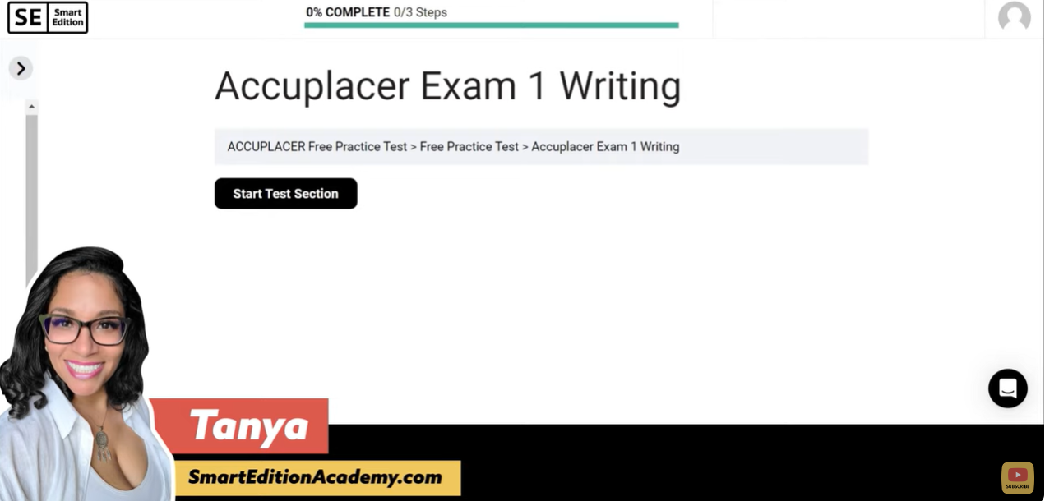
Writing
https://www.youtube.com/watch?v=m9DANCOv_KU

Slide 5
Additional Links
PrepSTEP
ACCUPLACER

Slide 6
Additional Links
https://ccv.edu/documents/2013/10/khan-academy-accuplacer-topic-map.pdf/

